Slide 1

Black AI Assistant
for Information Gathering

Slide 2

Introduction:
Welcome to the unveiling of Black AI, an innovative software designed to revolutionize information gathering in the digital age. Black AI represents a culmination of my final year project, offering a comprehensive solution to streamline the process of accessing, organizing, and utilizing vast amounts of information available on the internet.

Slide 3
Importance of Information Gathering:
In today's fast-paced world, the ability to swiftly gather accurate and relevant information is indispensable. Whether it's for academic research, professional analysis, or personal enrichment, the efficiency and effectiveness of information retrieval significantly impact decision-making and productivity. However, the overwhelming volume and dispersed nature of online data pose considerable challenges to individuals seeking to extract valuable insights.

Slide 4
Role of Black AI in Assisting with Information Gathering:
Enter Black AI—a cutting-edge assistant empowered by Artificial Intelligence (AI) to tackle the complexities of information retrieval head-on. With its advanced algorithms and natural language processing capabilities, Black AI navigates through the labyrinth of online resources, swiftly identifying and extracting pertinent information. More than just a search tool, Black AI embodies versatility, offering a range of functionalities to meet diverse user needs.

Slide 5
Objective:
Goals and Objectives of Black AI:
Develop an advanced AI assistant, Black AI, with the capability to efficiently gather information from various online sources.
Enable Black AI to perform specific tasks such as creating Word and PowerPoint files, searching topics on Google, and playing videos on YouTube.
Implement adaptive learning algorithms to personalize the user experience and enhance efficiency over time.
Problem Statement: The proliferation of information on the internet presents a significant challenge for individuals seeking to access and utilize relevant data efficiently. Existing tools often lack the versatility and integration necessary to streamline the information gathering process, leading to inefficiencies and frustration among users. Black AI aims to address these challenges by offering a comprehensive solution that combines advanced AI capabilities with a diverse range of functionalities.

Slide 6
Literature Review: Existing AI assistants and information gathering tools provide convenience but are limited in scope and functionality. Black AI builds upon this work by introducing innovative features such as seamless integration with external applications and adaptive learning algorithms to personalize the user experience.

Slide 7


Front Layout Home Page

Slide 8
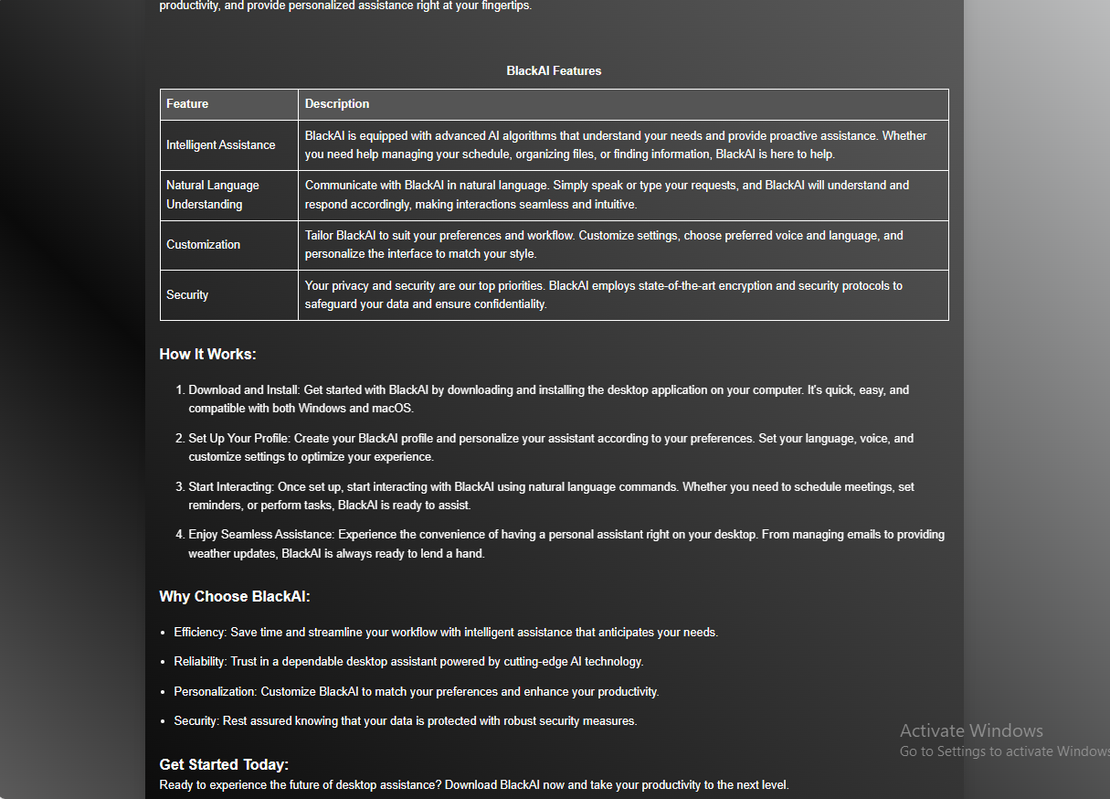
Front Layout Home Page

Slide 9
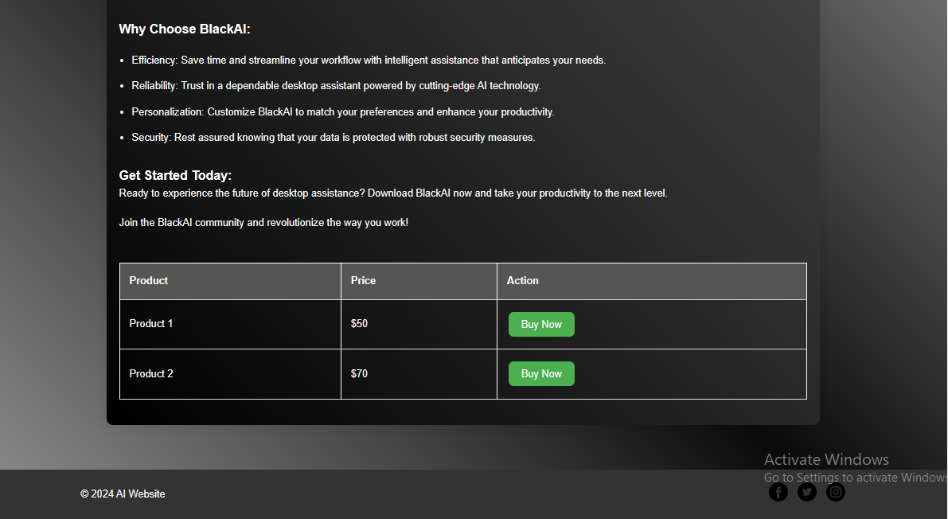
Front Layout Home Page

Slide 10
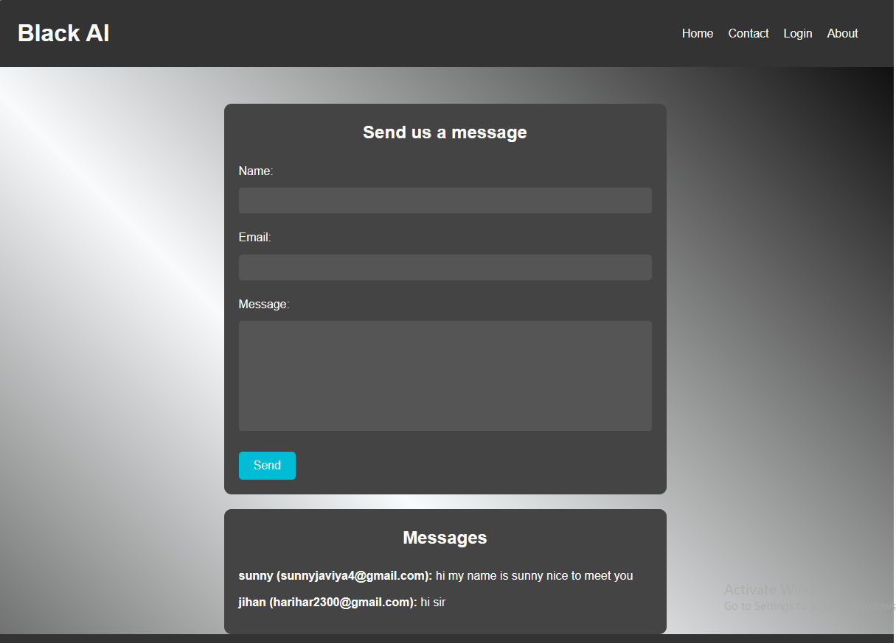
Front Layout Contact Page

Slide 11
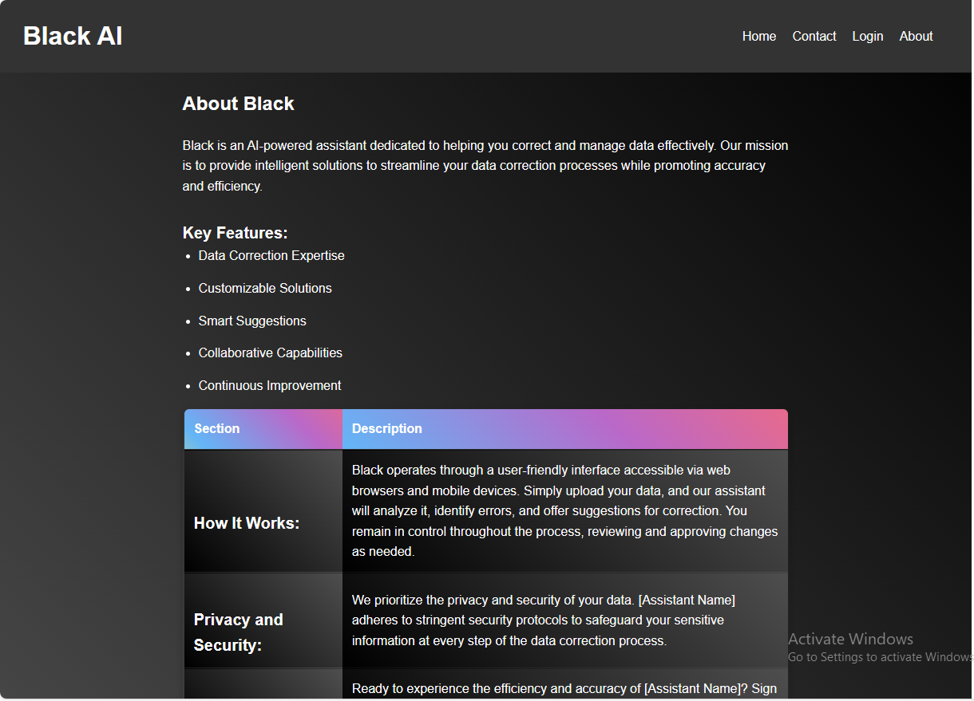
Front Layout About Page

Slide 12
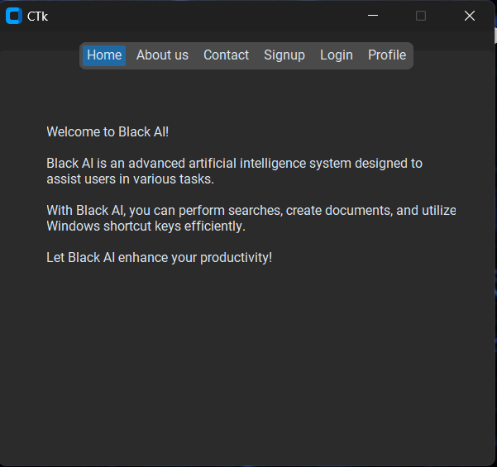
Front Layout About Page

Slide 13
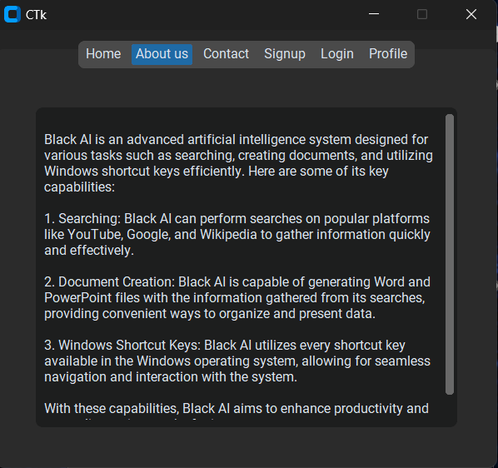
Front Layout About Page

Slide 14
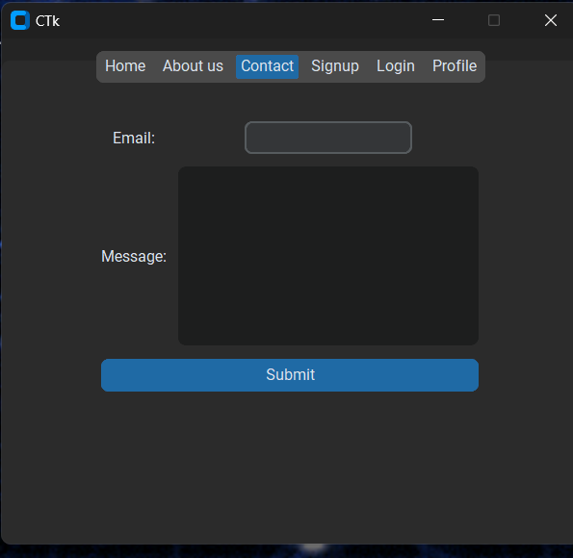
Front Layout About Page

Slide 15
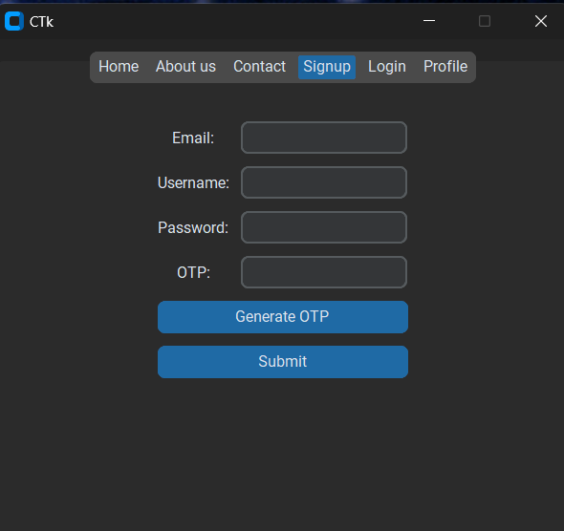
Front Layout About Page

Slide 16
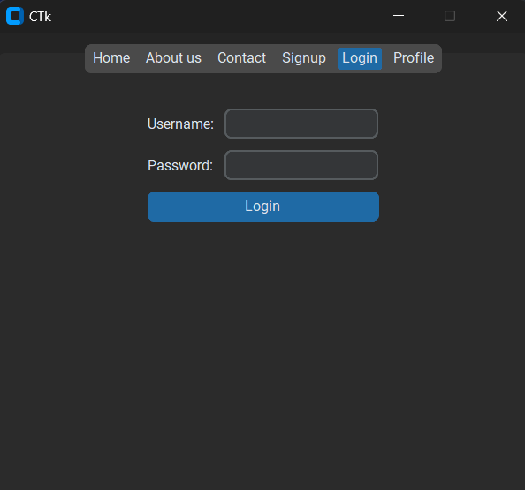
Front Layout About Page

Slide 17
Front Layout About Page

Slide 18

Front Layout About Page

Slide 19
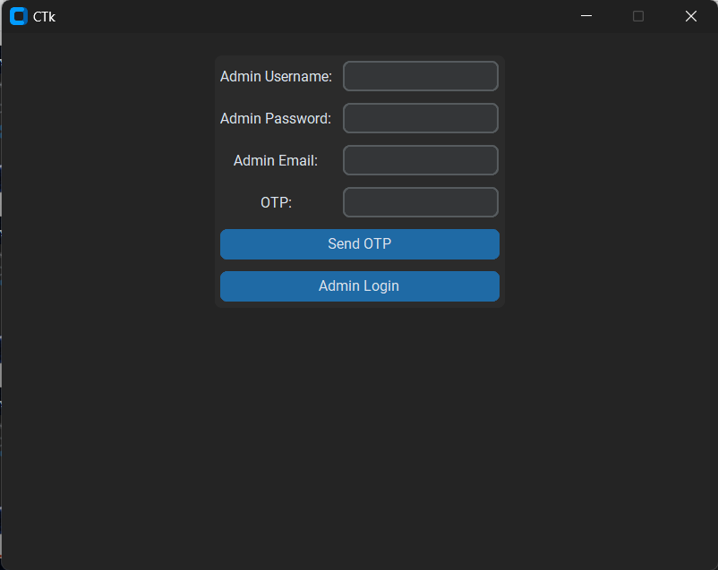
Front Layout About Page

Slide 20
Front Layout About Page

Slide 21
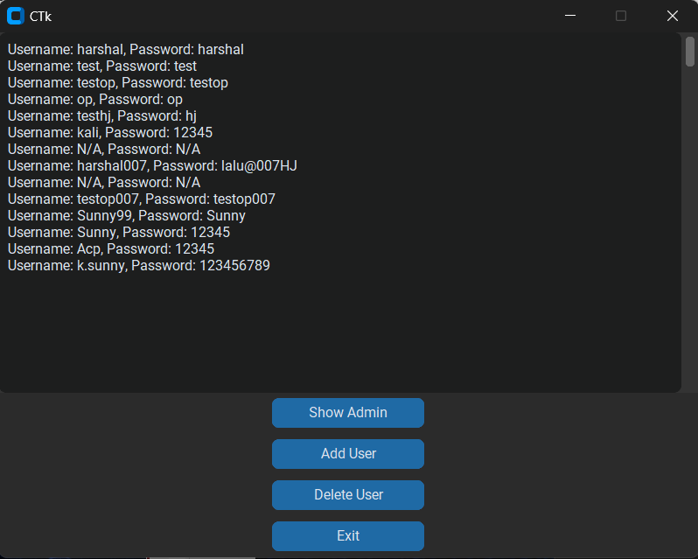
Front Layout About Page

Slide 22
Front Layout About Page

Slide 23
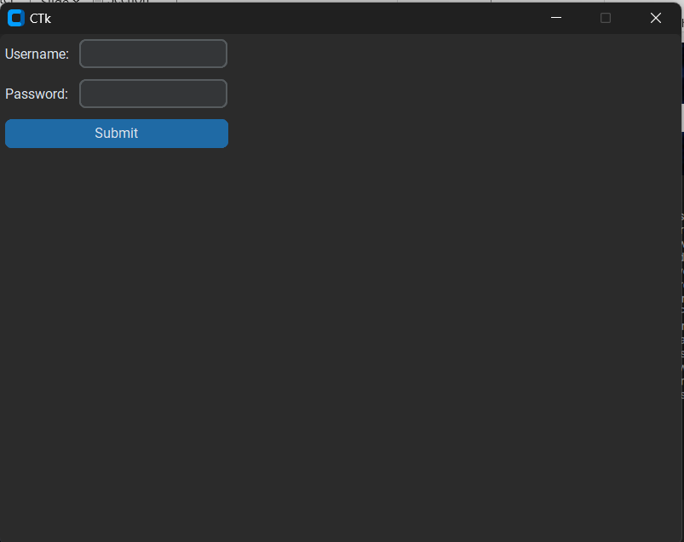
Front Layout About Page

Slide 24

Front Layout About Page

Slide 25
Front Layout About Page

Slide 26
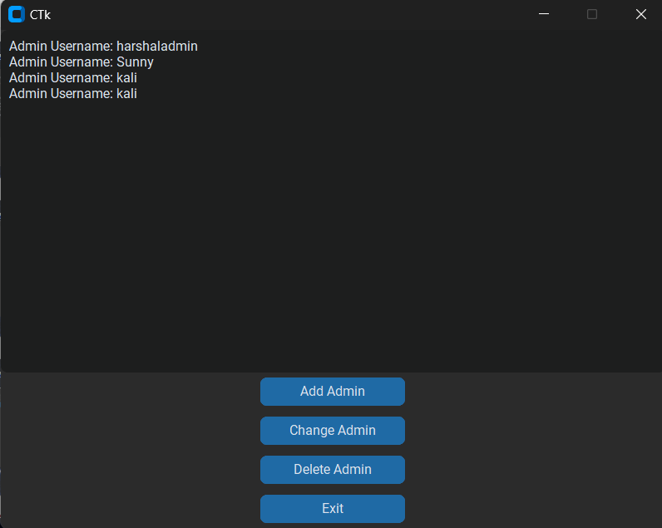
Front Layout About Page

Slide 27
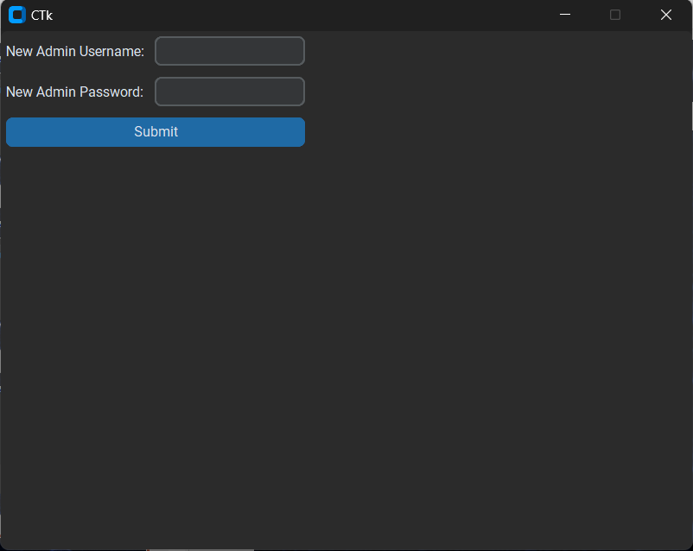
Front Layout About Page

Slide 28
Front Layout About Page

Slide 29
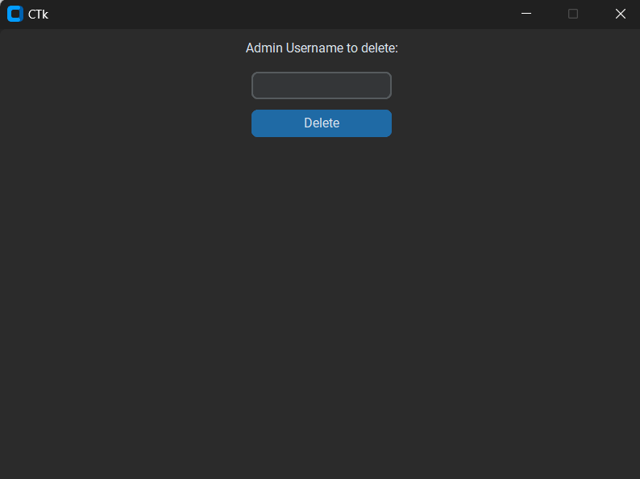
Front Layout About Page

Slide 30
Front Layout About Page

Slide 31
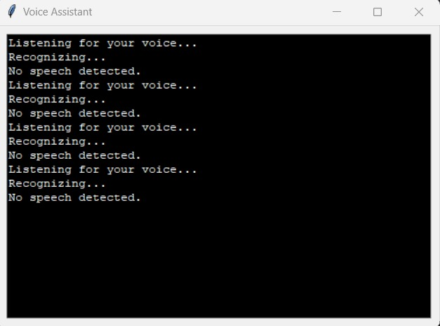
Front Layout About Page

Slide 32

Hardware Requirement :-
Laptop
Software/Tools Requirement
Vscode
Proposed Implementation Language(s)
Reactjs JavaScript
Python 3d CSS
Mongodb

Slide 33

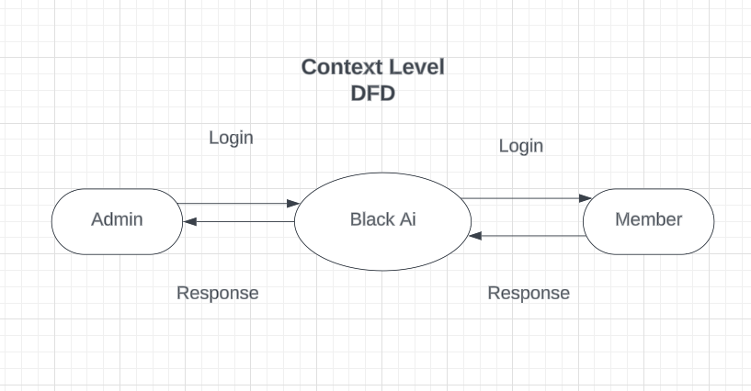
Diagram

Slide 34
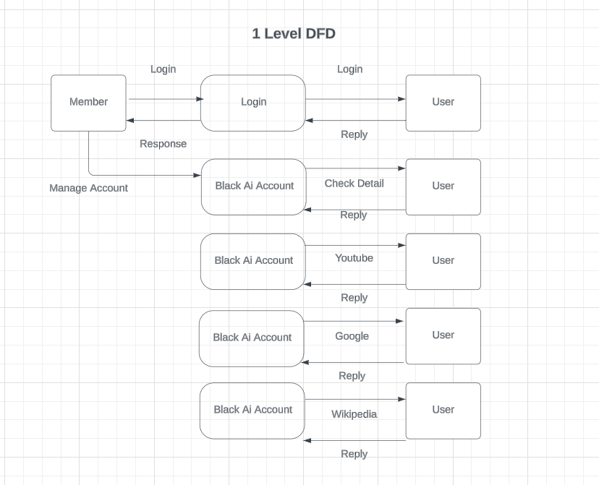
Diagram

Slide 35
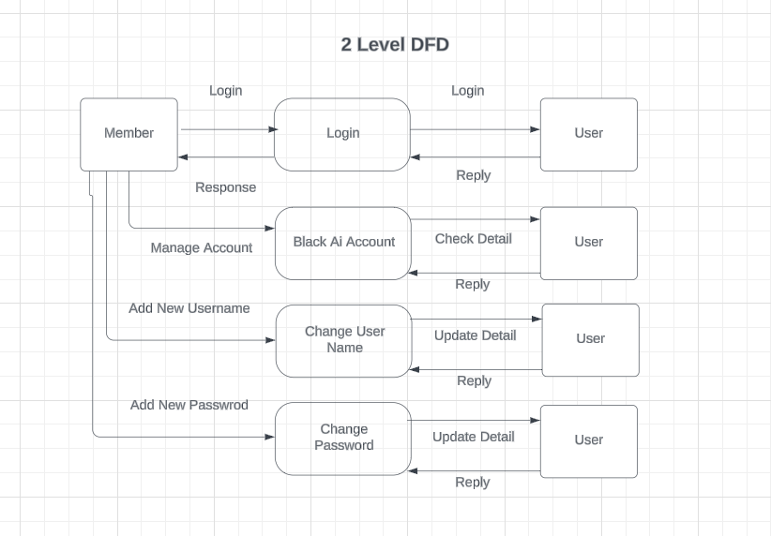
Diagram

Slide 36
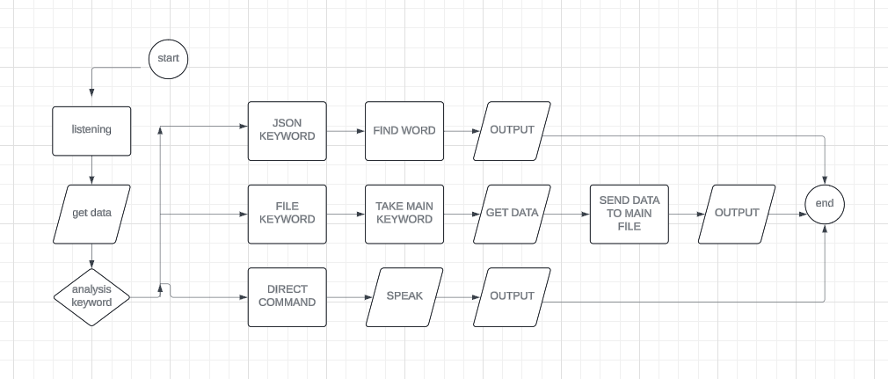
Diagram

Slide 37

Conclusion:
In conclusion, Black AI represents a significant leap forward in the realm of AI-powered assistants, offering a robust solution to the challenges of information gathering in the digital age. By seamlessly integrating advanced AI capabilities with a diverse range of functionalities, Black AI streamlines the process of accessing, organizing, and utilizing online data.
Through this project, we have demonstrated the potential of AI to enhance efficiency, productivity, and user satisfaction in information retrieval tasks. By addressing the limitations of existing solutions and introducing innovative features such as adaptive learning algorithms and seamless integration with external applications, Black AI empowers users to harness the power of information more effectively than ever before.
As we look to the future, the possibilities for Black AI are boundless. With continued development and refinement, Black AI has the potential to become an indispensable tool for individuals across various domains, from academia and research to business and personal productivity.
In closing, I would like to express my gratitude to all those who have supported and contributed to the development of Black AI. Together, we have embarked on a journey to unlock new possibilities and redefine the way we interact with information in the digital age.
Thank you.

Slide 38
Thank you

